Slide 1






letter of the day:
Ee

Slide 2


Read it:
E
e
Shaima almaazmi

Slide 3
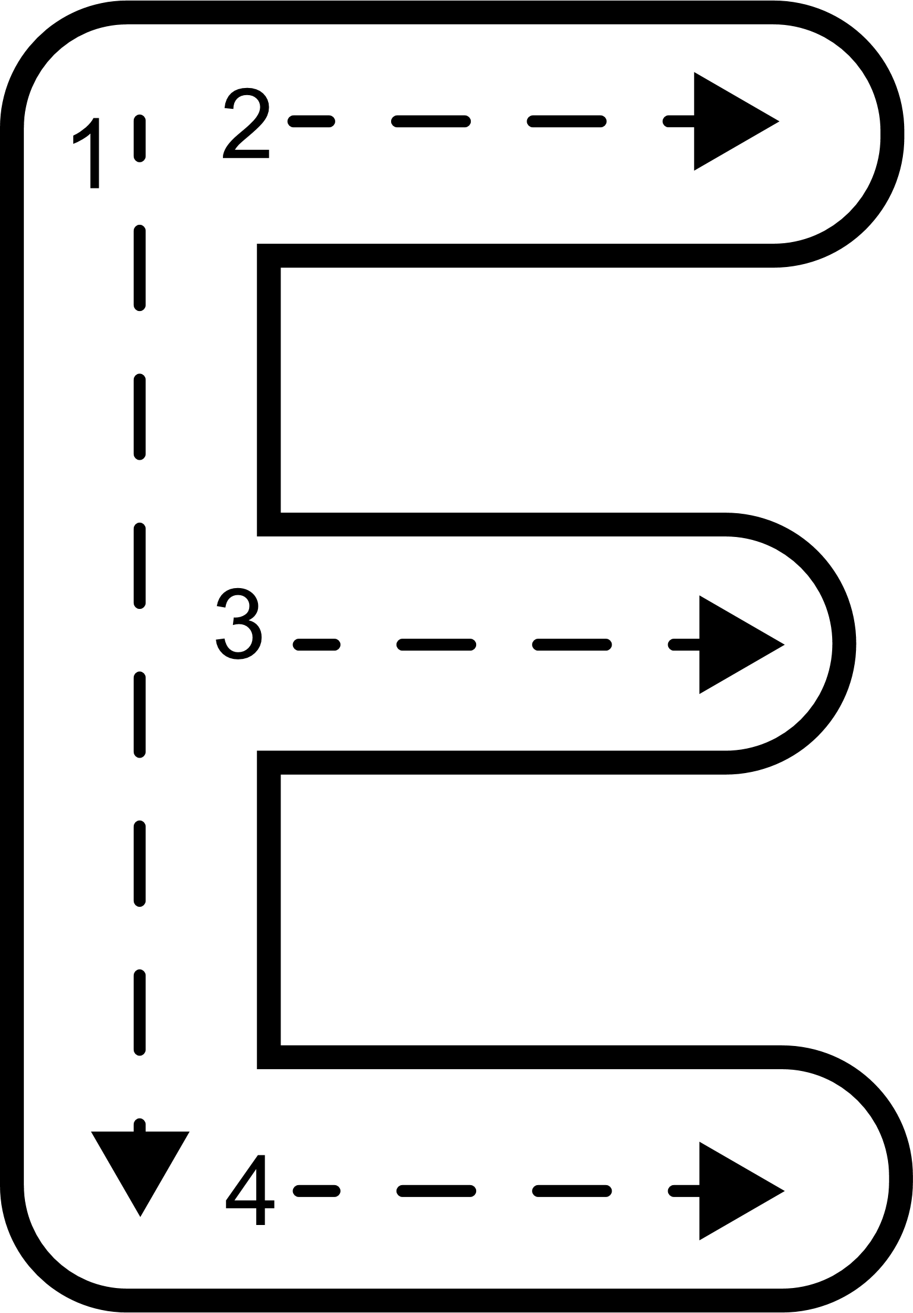
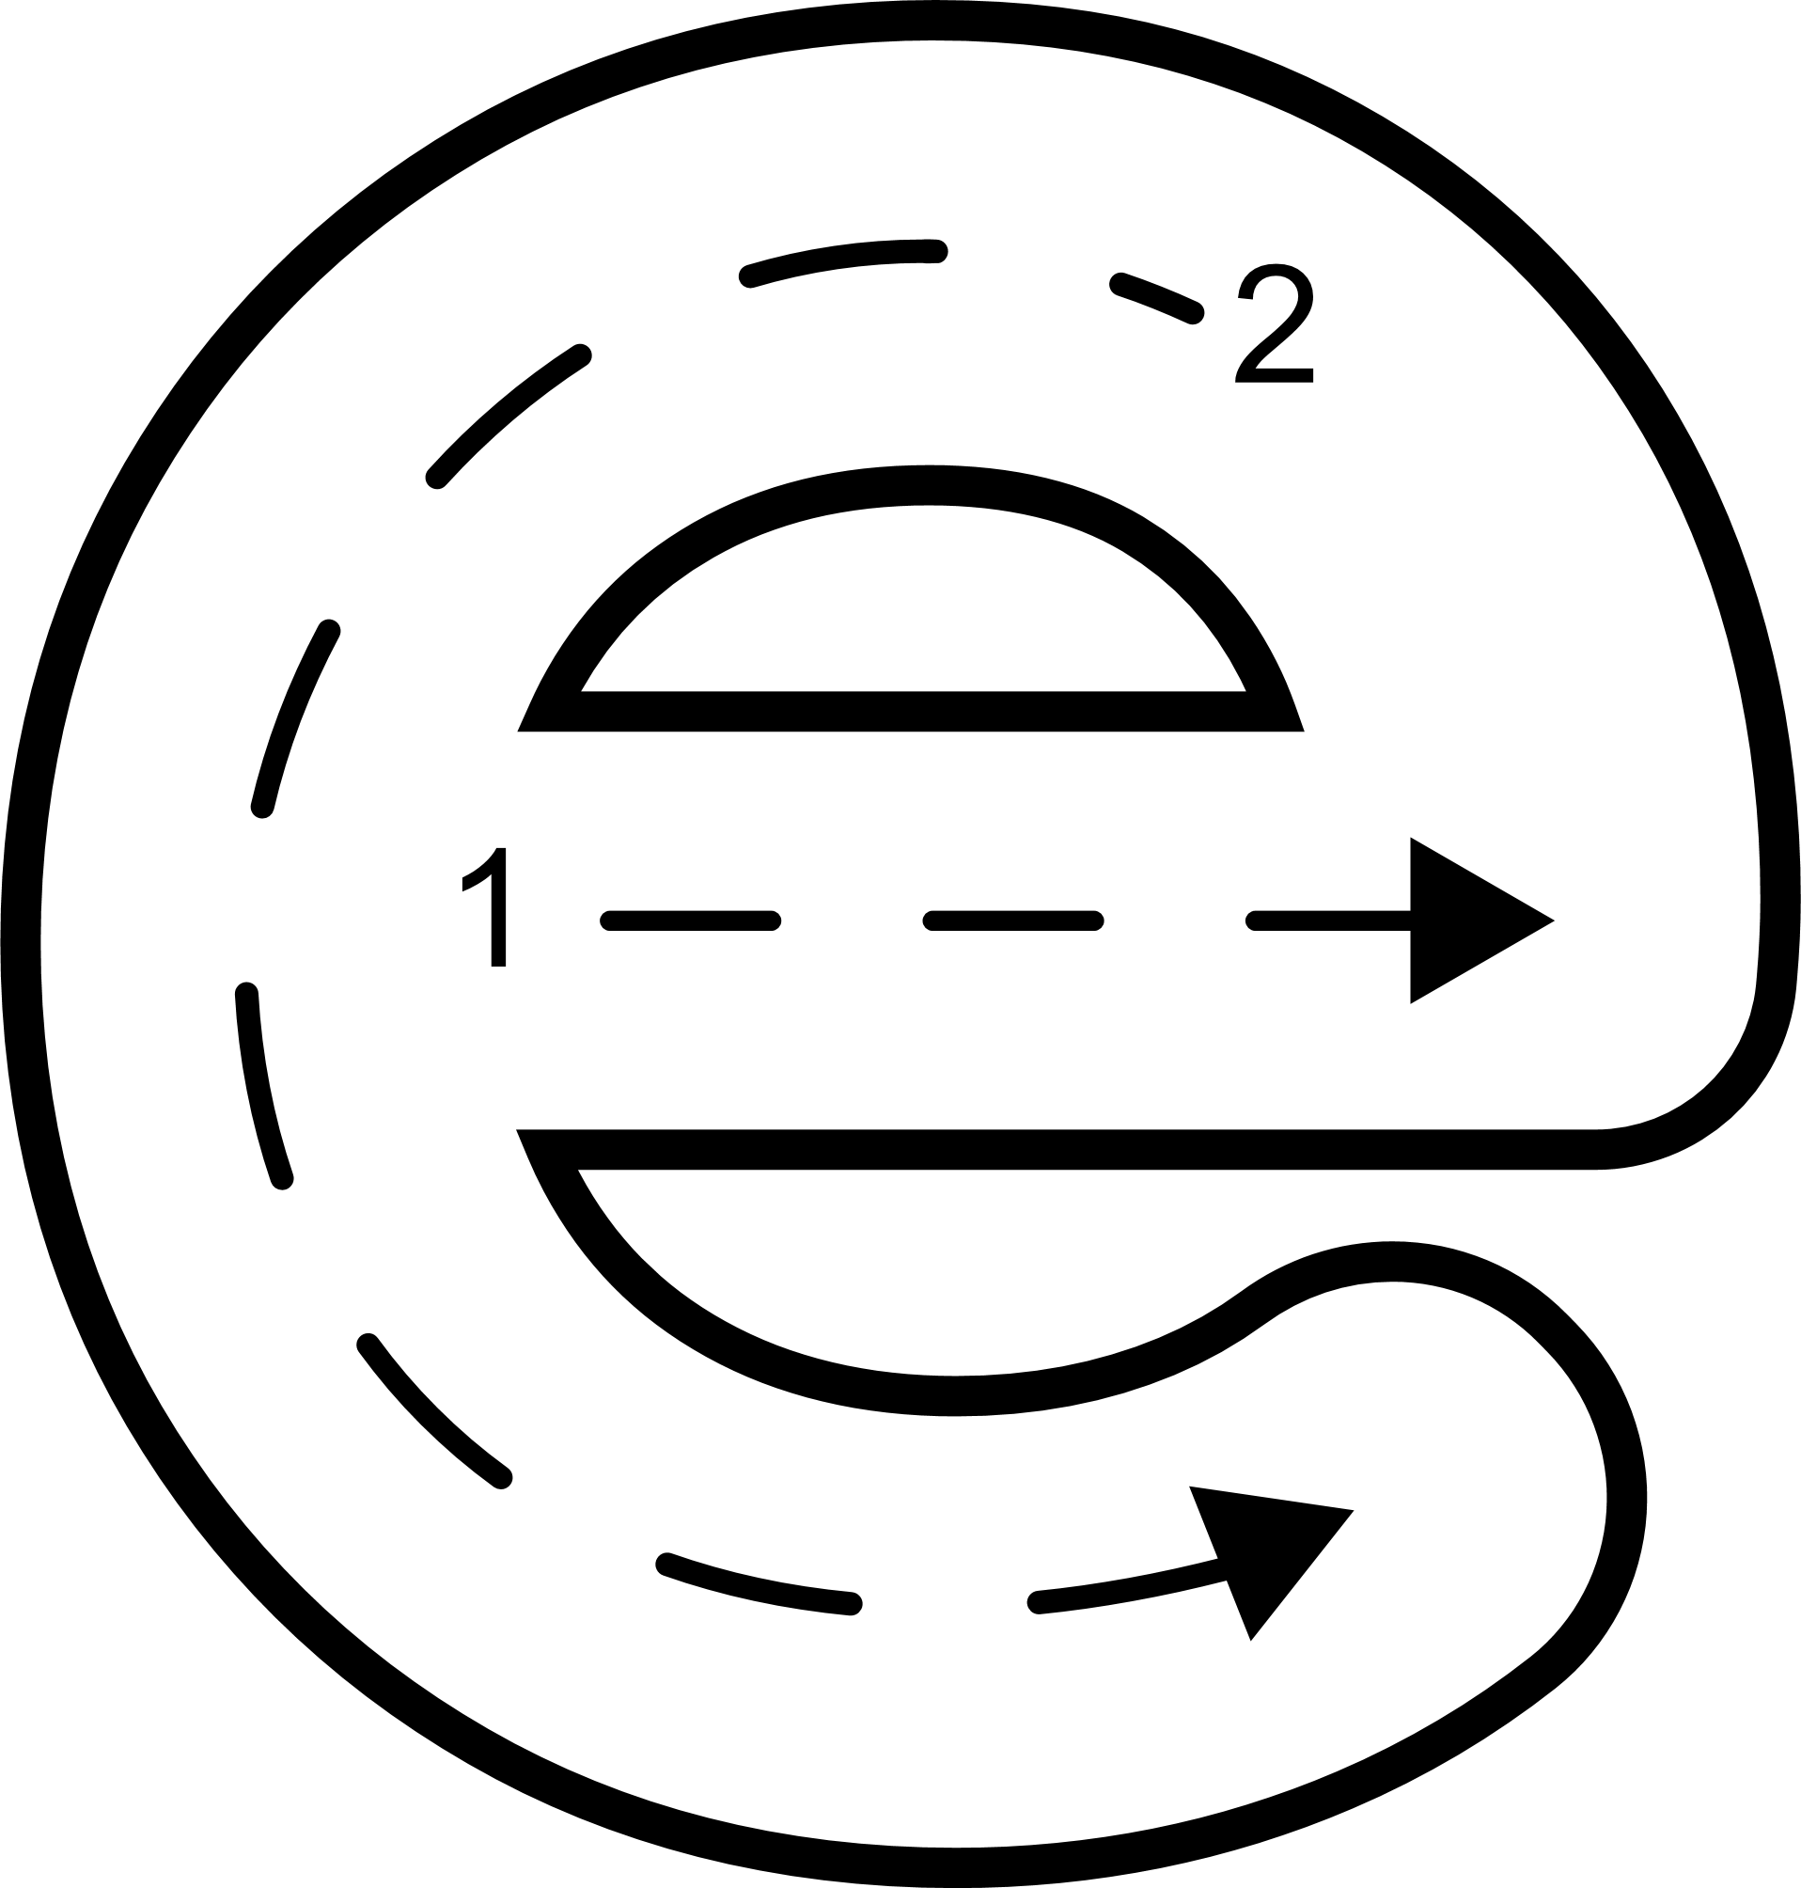

Trace it:
Shaima almaazmi

Slide 4

draw a line:
A
E
E
D
e
E
Shaima almaazmi

Slide 5

Find letter e and trace itit:
E
S
J
Shaima almaazmi

Slide 6
Find letter e and trace itit:
A
R
E
Shaima almaazmi

Slide 7
Find letter e and trace itit:
H
E
T
Shaima almaazmi

Slide 8






Things starts with e:
eye
egg
Envelope
elephant
eggplant
earth

Slide 9



Elephant

Slide 10

Egg

Slide 11

Eat

Slide 12

Ear

Slide 13
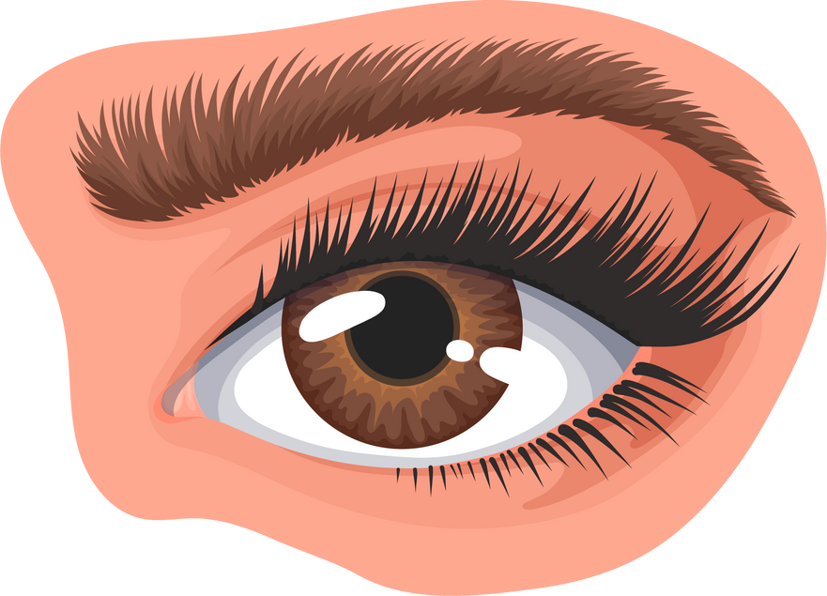
Eye

Slide 14

Eight

Slide 15
Eggplant

Slide 16


find things starts with e:

Slide 17

Circle letter e:
Egg

Slide 18
Circle letter e:
Eye

Slide 19
Circle letter e:
Elephant

Slide 20
Circle letter e:
Eight

Slide 21
Circle letter e:
Eat

Slide 22
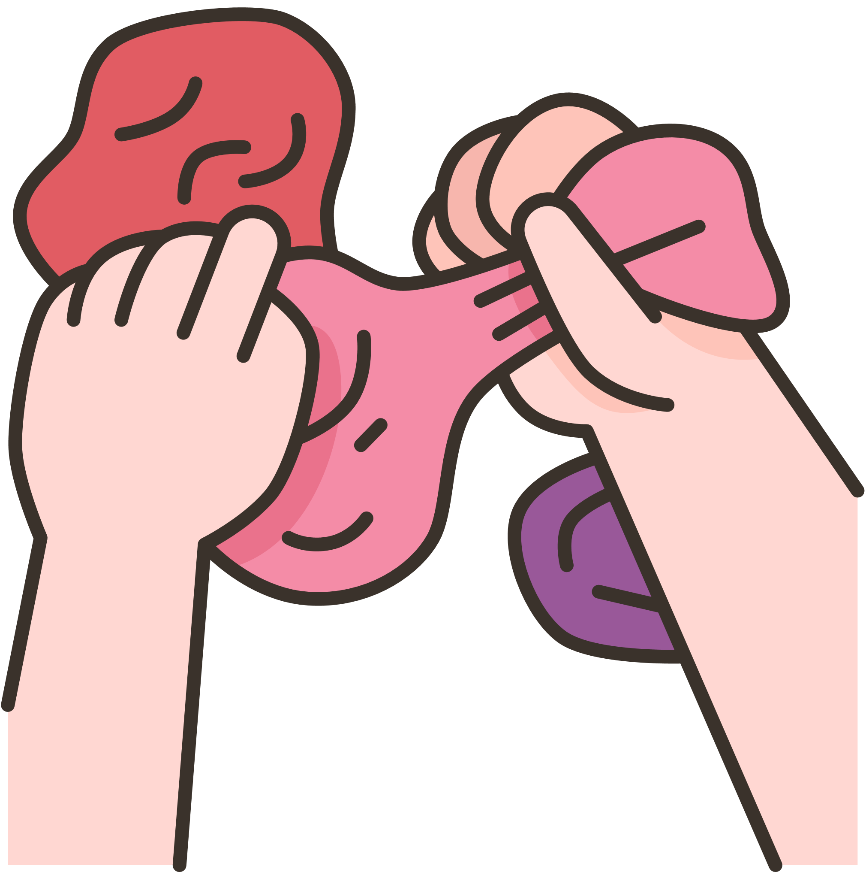
Can you make letter
E
using playdough?

Slide 23
Well done!

